Slide 1
Sentiment Analysis on Restaurant Tweets in R
Leila Ouellaj, Puneet Bhatia, Laith Barakat
IS 8070 Spring 2020

Slide 2
Available Tools for Sentiment Analysis
There are two categories of tools available for sentiment analysis: open source and Software as a Service (SaaS).
Open Source APIs for Sentiment Analysis –
Python – NLTK, SpaCy, Scikit-learn, TensorFlow, PyTorch, Keras
Java – CoreNLP, OpenNLP, Weka
SaaS APIs for Sentiment Analysis – MonkeyLearn, Google Cloud NLP, IBM Watson, Lexalytics, MeaningCloud, Amazon Comprehend, Aylien

Slide 3

Overview of Chosen Software
Academia: R is a very popular language in academia
Data wrangling: R has extensive library tools
Data visualization: R provides multiple easy to use packages
Specifity: R was designed for statistical analysis
Machine Learning: R provides and develops tools for data science
Availability: R is open source

Slide 4


Description of Packages
SentimentR
syuzhet
Used for calculating text polarity sentiment
Out-of-the-box solution packages for introductory text mining
Pros: open source and easy to adapt, bring in new dictionaries
Cons: less sophisticated than other available tools on the market

Slide 5
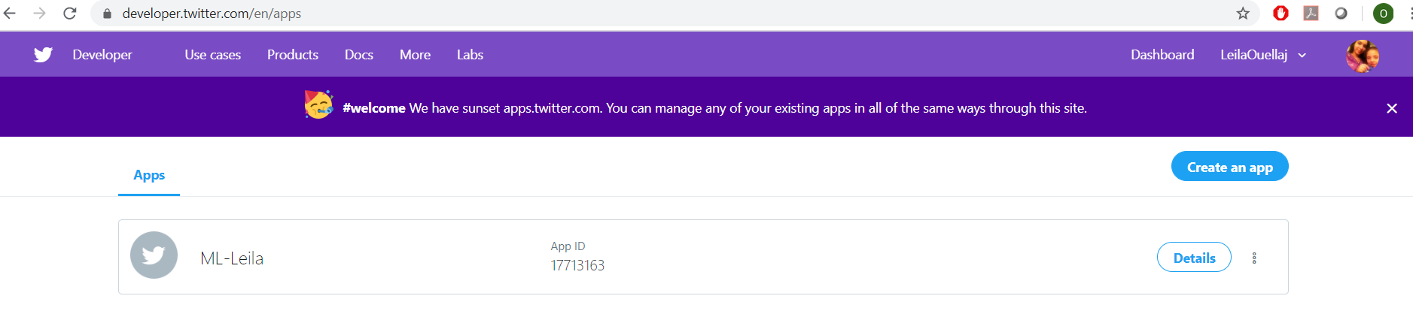
Demonstration
Data collection using Twitter API

Slide 6
Demonstration
Tokenization by removing uninformative words
Using the tokenized tweets as input to the functions
Scoring the tweets and classify them into positive and negative
Visualizing the ouput using bar charts

Slide 7






Results
Voice of the Customer (VoC)
Market Structure Analysis

Slide 8
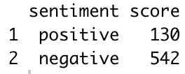
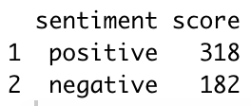
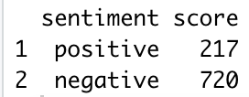
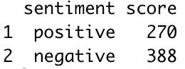
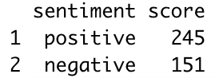
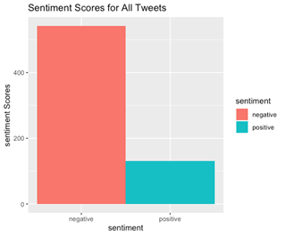
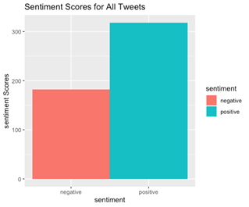
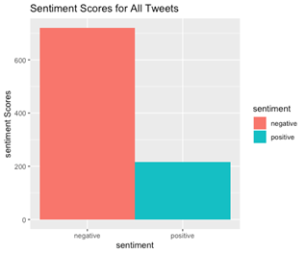
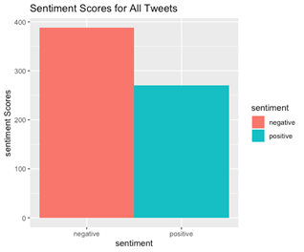
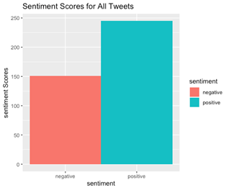
Results

Slide 9


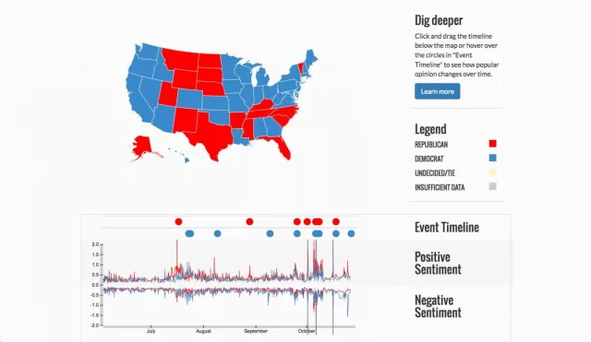

Future Trends
Greater sophistication (sarcasm, nuanced tone)
Larger-scale applications (politics & society)

Slide 10
Q&A / Thank you

